Slide 1
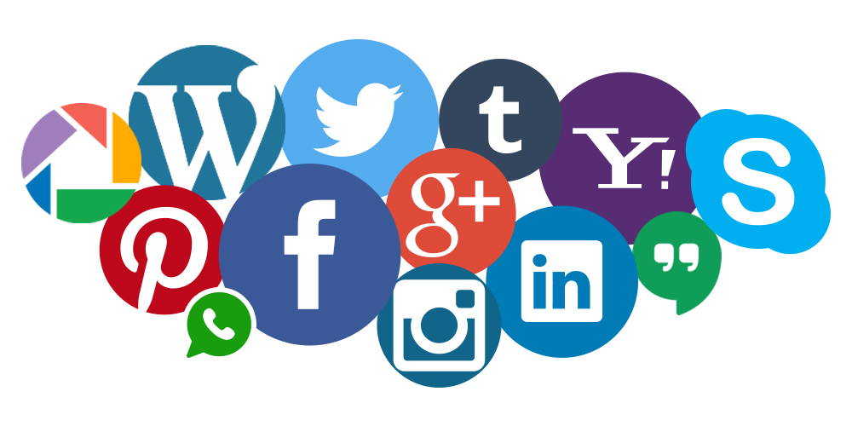
Dietitians in business and communication (DBC)
OPIM 5894 Social Media Analytics
Suraj Kumar, Raghavendiran Nagarajan, Niranjana Selvaraj, Shu-Feng Tsao

Slide 2
agenda
Introduction
Audience
Social Media Strategy
Measurement and Evaluation
Timeline
Budget
Appendix
Reference

Slide 3




Introduction
Current State: Multiple student members approach same business professionals independently
Opportunity: Enables optimized interactions between student members and business professionals on social platforms.
DBC
DBC
Student Members
Professionals
Student Members
Professionals

Slide 4
Our audience
Goals: Increase revenues from the student population
Current student members: 71, 6% of total members
Have 1,500 DBC student members by 2020
Student member fee: $20.00/year
Audience: Students with nutrition-related majors
Undergraduates & graduate students
Age >= 18
Females : Males = 27:1

Slide 5


Our audience
DBC
website
Posts, Pictures, Links
Announcements, Links, Photos
Posts
B
A
C
Dietitians in Business and Communications (DBC)

Slide 6
Social media strategy -- Facebook
Events and RSVP
Increase visibility
Introduce attention seeking words (hashtag)
Media content: Posts, Motivational images, DBC Videos

Slide 7
Social media strategy -- Twitter
Holding student-oriented discussions about nutrition, such as Twitter chats
Twixclusive deals: Discounts on membership fees or regional events
Twitter Advertisements (in the future)
Post questions about nutrition to promote retweet and response.
Promoting Holiday Recipe Competition: Christmas and/or Thanksgiving

Slide 8
Social media strategy -- LinkedIn
For Recruitment/Volunteering/Jobs
Exclusive educational webinars for student members
Jobs and internships – Newsletters
Networking Events
Volunteers for national and International conferences

Slide 9
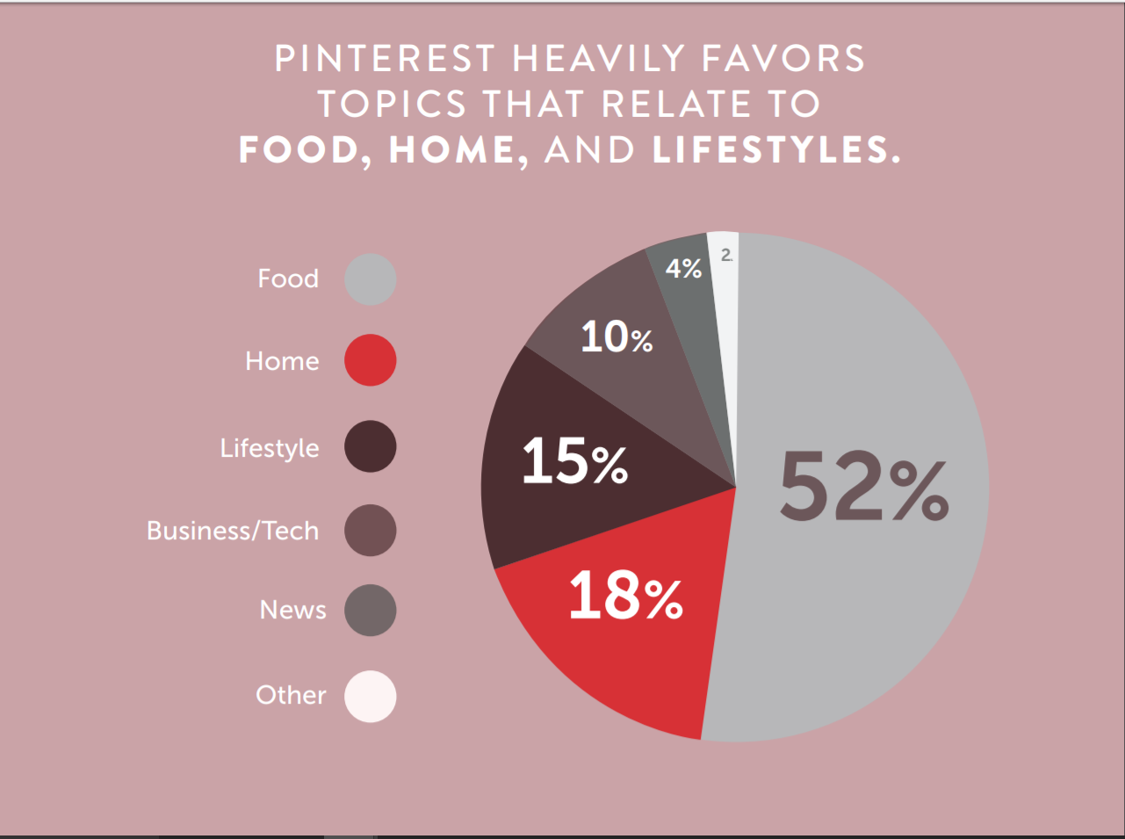
Social media strategy -- Pinterest
79% female to 21% male
Pinterest favors topics like food, home and lifestyle

Slide 10
Pinterest
Universities showing interest towards Pinterest are increasing
University Of Oregon, Duke University and Clemson
Creates more website traffic through pins and boards

Slide 11
Measurement & evaluation

Slide 12
Social Media Platform
Type of Social Media | Tools Used to track Performance | Reason to select
Facebook | Facebook Insight | Free, Insightful, Facebook inbuilt
Twitter | Twitter Analytics | Free, Easy to use, Twitter Inbuilt
LinkedIn | LinkedIn Analytics | Free, Insightful, LinkedIn Inbuilt
Pinterest | Pinterest analytics | Free, Concise Pinterest Inbuilt

Slide 13
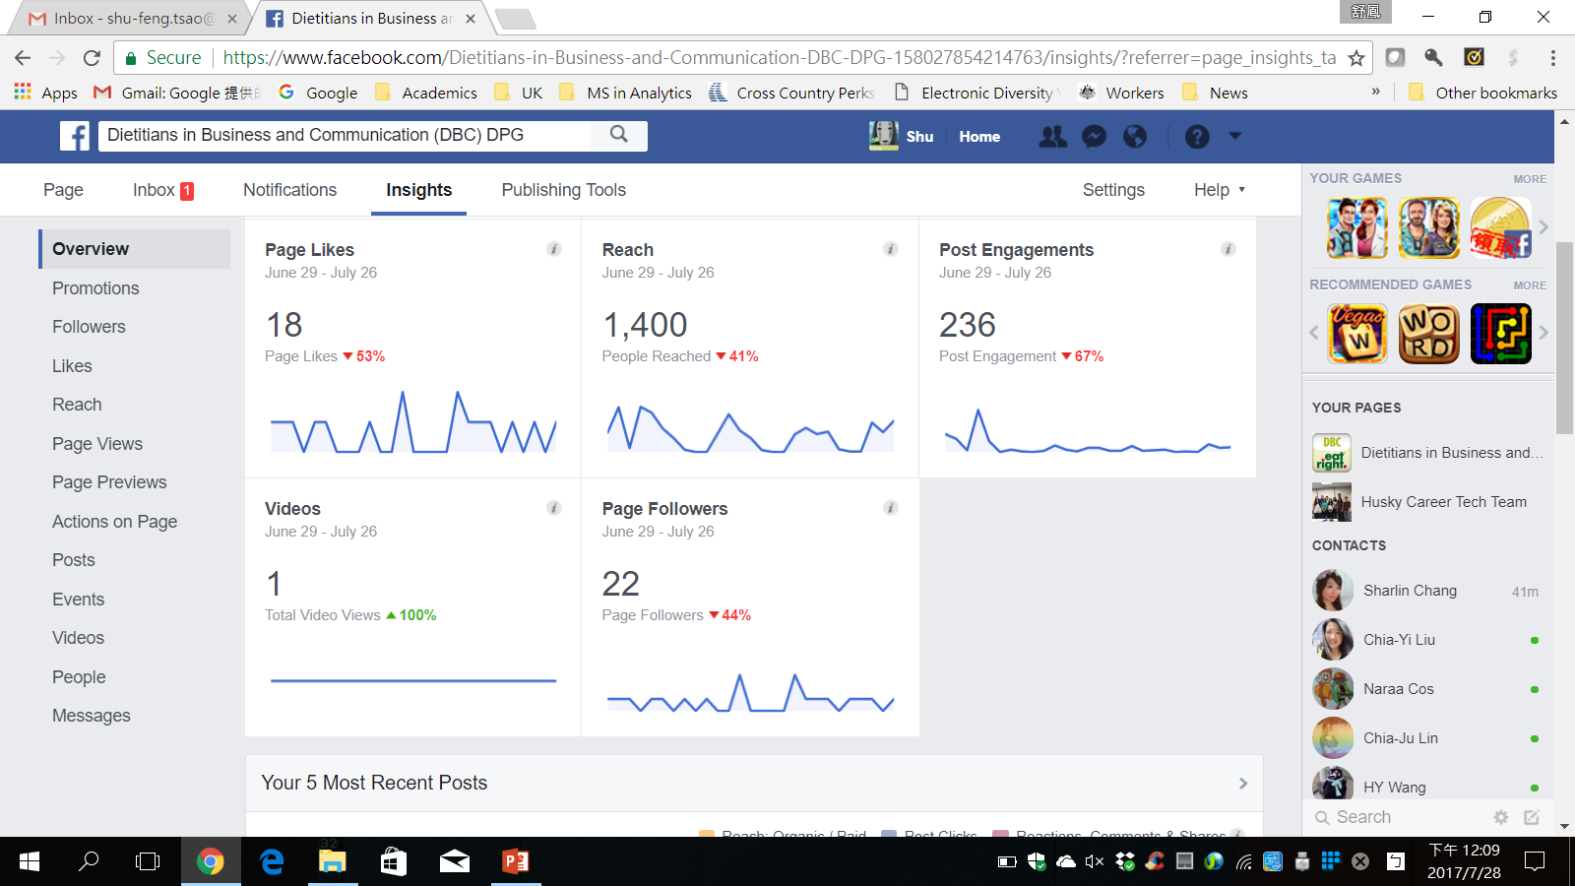
Facebook Insight

Slide 14
Facebook Insight
Metric | What | When
Likes | Total page likes till today Net likes | Weekly, monthly
Reach | Post Reach, Likes, Comments and Shares, Hide, Report as spams and Unlike | Daily, weekly, monthly
Page Views | Total Views Total people who viewed Top sources | Weekly, monthly
Posts | When your fans are online Posts Type Top posts from pages you watch | Weekly, monthly
People | Your fans People Reached People Engaged | Weekly, monthly

Slide 15
Twitter Analytics
Metric | What | When
Trend Data | Is it upward, downward or flat? Where will be in next days or month | Weekly, monthly
Average Performance | Benchmark against the goal | monthly
Engagement | Retweets – sign of value Likes – sign of appreciation | Daily , weekly, monthly
Engagement rate | Which post doing best Engagement rate and impressions | Weekly, monthly

Slide 16
Pinterest Analytics
Metric | What | When
Pins from your website | Trend of pins generated Percentage of change over a time period | Weekly, monthly
Repins from your website | Average number of pins that got repined | Weekly, monthly
Reach | Average number of people who saw your pins | Weekly, monthly
Visit and Visitors | Number of visits and visitors | Weekly, monthly

Slide 17
LinkedIn Analytics
Metric | What | When
Updates | Clicks, Interactions Followers Acquired | Weekly, monthly
Followers | Total Followers, Demographics- seniority, job function, Follower Trends | Weekly, monthly
Visitors | Page Views Career Page Clicks | Daily , weekly, monthly

Slide 18
Timeline
Facebook (Aug 2017 - Jul 2020)
Twitter (Aug 2017 - Jul 2020)
LinkedIn (Aug 2017 - Jul 2020)
Pinterest (Aug 2019 - Jul 2020)
Tool/App | Person responsible | Activities | Duration
Twitter | Sarah Hendren | Post ≥ once / week | 8/01/17 – 7/31/20
Facebook | Tyler Rolling | Post ≥ once / week | 8/01/17 – 7/31/20
LinkedIn | Alexis Ray | Post ≥ once / week | 8/01/17 – 7/31/20
Pinterest | Barb Pyper | Post ≥ once / week | 8/01/19 – 7/31/20

Slide 19
Budget
Tool/App/Technology | Year 1 (Aug 2017 – Jul 2018) |  | Year 2 (Aug 2018 – Jul 2019) |  | Year 3 (Aug 2019 – Jul 2020)
 | $ | Time | $ | Time | $ | Time
Social Media Platforms
Facebook | 0 | 420 hrs | 0 | 420 hrs | 0 | 420 hrs
Twitter | 0 | 420 hrs | 0 | 420 hrs | 0 | 420 hrs
LinkedIn | 0 | 420 hrs | 0 | 420 hrs | 0 | 420 hrs
Pinterest | 0 | 0 | 0 | 0 | 0 | 420 hrs
Measurement Tools
Facebook insight | 0 | 200 hrs | 0 | 200 hrs | 0 | 200 hrs
Twitter analysis | 0 | 200 hrs | 0 | 200 hrs | 0 | 200 hrs
LinkedIn analysis | 0 | 200 hrs | 0 | 200 hrs | 0 | 200 hrs
Pinterest analysis | 0 | 0 | 0 | 0 | 0 | 200 hrs
Total | 0 | 1,860 | 0 | 1,860 | 0 | 2,480

Slide 20
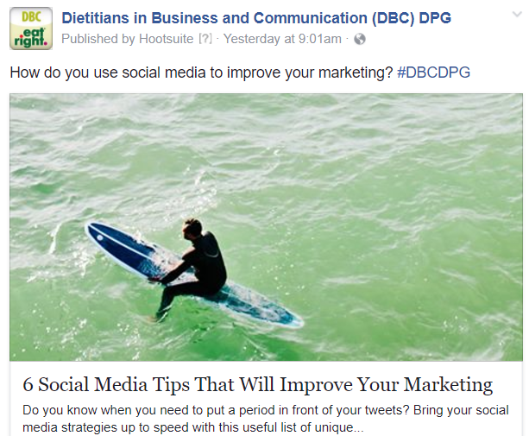
Appendix--Facebook

Slide 21
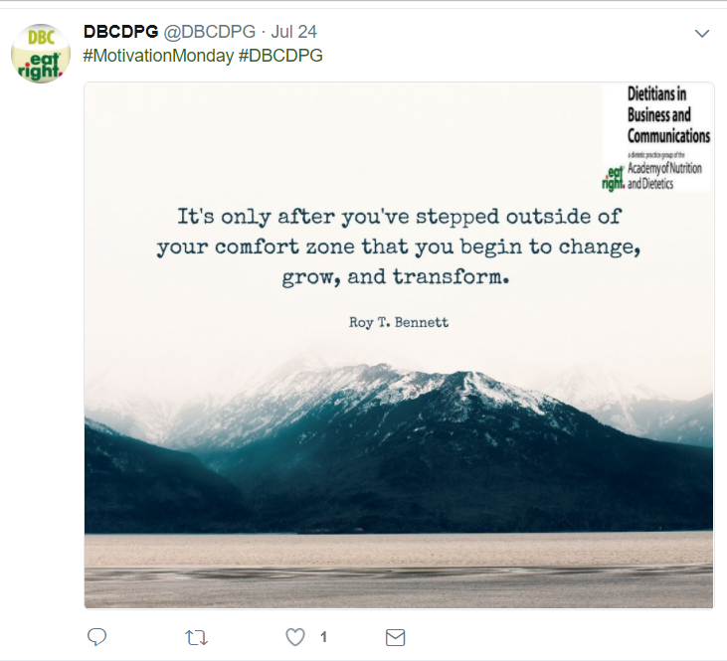
Appendix--Twitter

Slide 22
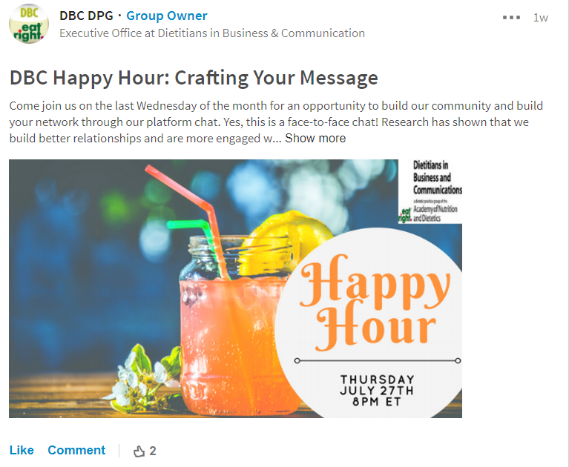
Appendix--LinkedIn

Slide 23
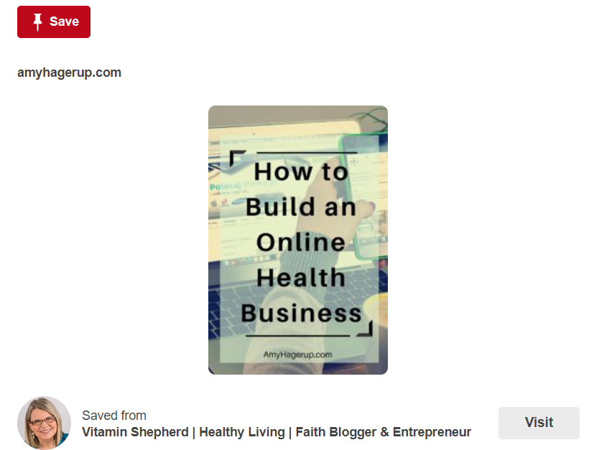
Appendix--Pinterest

Slide 24
References
https://blog.hootsuite.com/facebook-analytics-insights-beginners-guide/
Dietitians in Business and Communication (DBC) DPG on Facebook: https://www.facebook.com/Dietitians-in-Business-and-Communication-DBC-DPG-158027854214763/
Dietitians in Business and Communication (DBC) DPG on Twitter: https://twitter.com/DBCDPG
Dietitians in Business and Communication (DBC) DPG on LinkedIn: https://www.linkedin.com/groups/1076937
https://www.facebook.com/business/a/page/page-insights#u_0_2
Pinterest example: How to build an online health business https://www.pinterest.com/pin/521784306810944876

